Slide 1

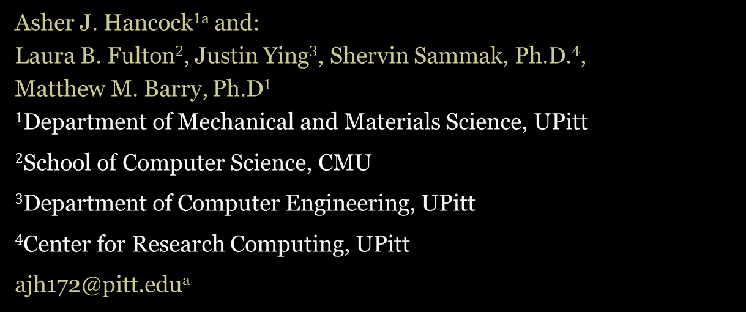
GPU-Accelerated Ray-Tracing Methods for Determining Radiation View Factors in Multi-Junction Thermoelectric Generators
Asher J. Hancock$1$ª and:
Laura B. Fulton$2$, Justin Ying$3$, Shervin Sammak, Ph.D.$4$,
Matthew M. Barry, Ph.D$1$
$1$Department of Mechanical and Materials Science, UPitt
$2$School of Computer Science, CMU
$3$Department of Computer Engineering, UPitt
$4$Center for Research Computing, UPitt
ajh172@pitt.eduª

Slide 2
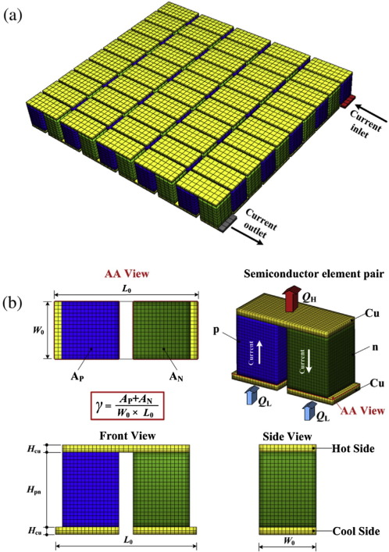
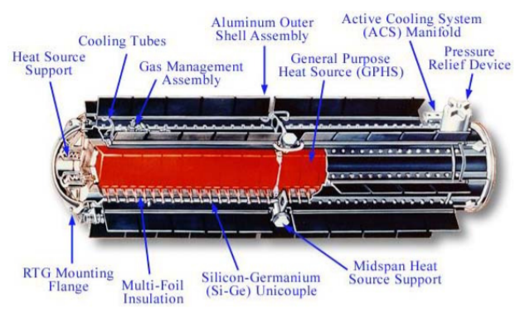
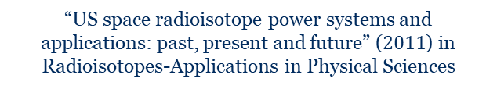
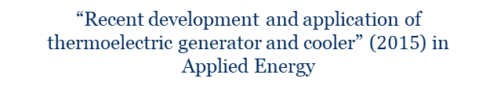

Background: Thermoelectric generators and uses
Outline:
Background
Motivation
Methodology
Validation
Results
Discussion
Conclusion
Thermoelectric generators (TEGs) are solid-state energy conversion devices
Show promise in space applications, as well as the automobile industries
“Recent development and application of thermoelectric generator and cooler” ($2015$) in Applied Energy
“US space radioisotope power systems and applications: past, present and future” ($2011$) in Radioisotopes-Applications in Physical Sciences
$2020$ July $22nd$
Notes:
TEGs have direct energy conversion, no moving parts (low complexity), and a long lifespan. Power generation for deep space missions and waste heat recovery for automobiles

Slide 3
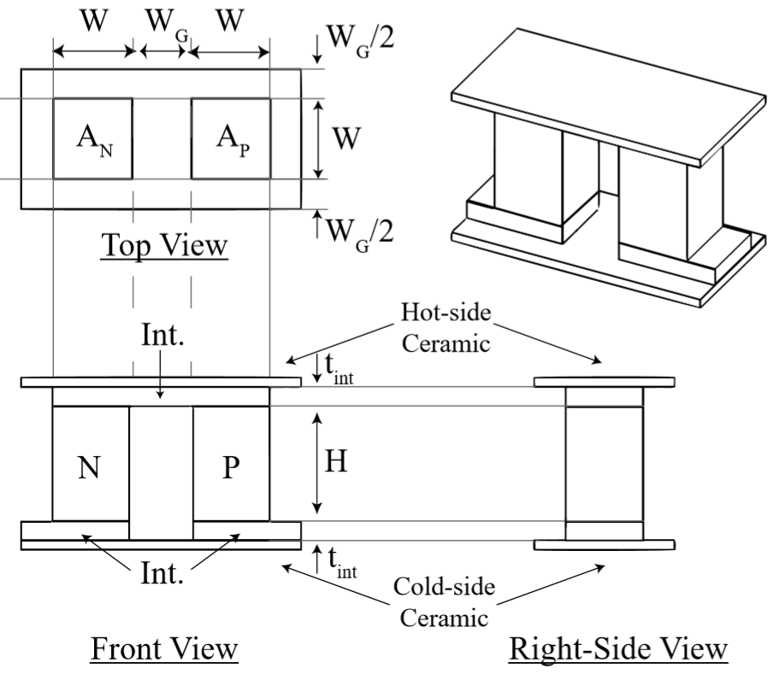
Background: TEG design
Outline:
Background
Motivation
Methodology
Validation
Results
Discussion
Conclusion
Basics of a unit-cell thermoelectric generator design
P- and N-type thermoelectric materials
Conductive interconnectors (Int.)
Heat source and heat sink
String multiple cells together to form a TE modules
$2020$ July $22nd$
Notes:
TEGs have direct energy conversion, no moving parts (low complexity), and a long lifespan. Power generation for deep space missions and waste heat recovery for automobiles

Slide 4
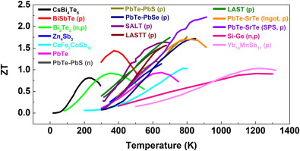
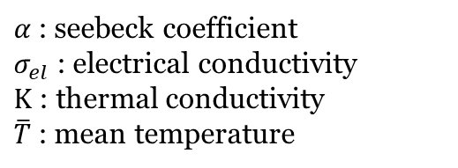

Background: TEG performance
Outline:
Background
Motivation
Methodology
Validation
Results
Discussion
Conclusion
$$Z\overline{T}= \frac{α^{2}σ_{el}}{Κ}\overline{T}$$
Figure of merit for TE materials ($Z\overline{T})$:
$α$: seebeck coefficient
$σ_{el}$: electrical conductivity
$Κ$ : thermal conductivity
$\overline{T}$: mean temperature
Performance rests upon optimizing temperature-dependent material properties and device design
Radiative heat transfer proportional to $T^{4}$
Minimize parasitic radiative transfer across the junction
“High performance bulk thermoelectrics via a panoscopic approach” ($2013$) in Materials Today
$2020$ July $22nd$
Notes:
TEGs have direct energy conversion, no moving parts (low complexity), and a long lifespan. Power generation for deep space missions and waste heat recovery for automobiles

Slide 5
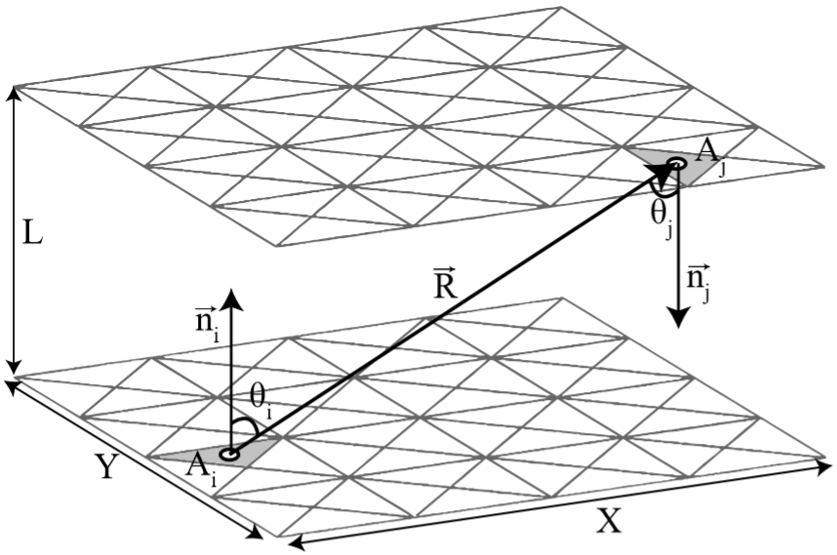



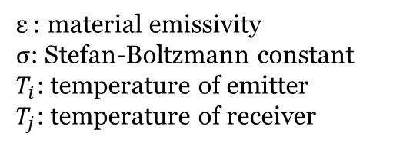
Motivation: View factor
Outline:
Background
Motivation
Methodology
Validation
Results
Discussion
Conclusion
$$F_{ij}= \frac{1}{A_{i}}\int{\int{\frac{\cos{θ_{i}}\cos{θ_{j}}}{π{\vec{R}}^{2}}}}dA_{i}A_{j}$$
Radiation view factor ($F_{ij})$:
A geometric property that quantifies the proportion of diffuse radiation emitted from one surface, $A_{i}$, and received by another surface, $A_{j}$
$$Q_{i}= εσA_{i}F_{ij}\left({T_{i}}^{4} −{T_{j}}^{4}\right)$$
Radiation Heat Transfer Rate ($Q_{i})$:
ε : material emissivity
σ: Stefan-Boltzmann constant
$T_{i}$: temperature of emitter
$T_{j}$: temperature of receiver
Why do we care?
Accurate heat transfer models
Parasitic radiative transfer that lowers temperature gradient
$2020$ July $22nd$
Notes:
TEGs have direct energy conversion, no moving parts (low complexity), and a long lifespan. Power generation for deep space missions and waste heat recovery for automobiles

Slide 6
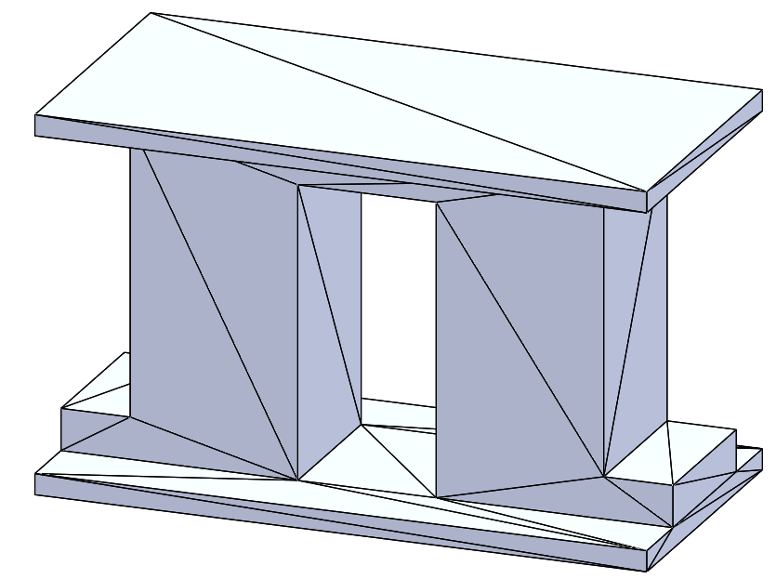
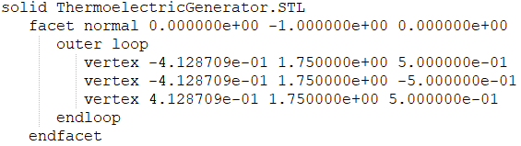
Methodology: GPU-accelerated programming and geometry definition
Outline:
Background
Motivation
Methodology
Validation
Results
Discussion
Conclusion
Graphics Processing Unit (GPU) can achieve massive runtime gains
Thousands of cores that operate in parallel
Computational structure is ideal for repetitive, algebraic tasks
Geometry Input: STL Files
Ubiquitous in CAD software
Robust geometry definition
Example STL format
Example TEG unit-cell defined in STL format
$2020$ July $22nd$
Notes:
TEGs have direct energy conversion, no moving parts (low complexity), and a long lifespan. Power generation for deep space missions and waste heat recovery for automobiles

Slide 7
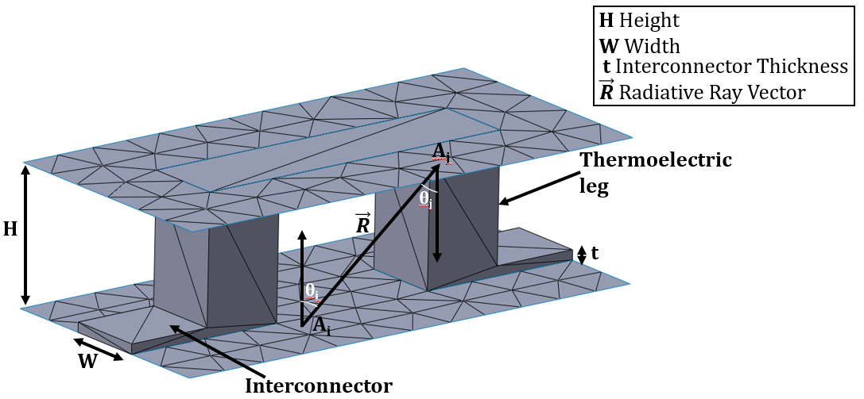
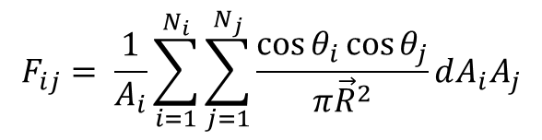
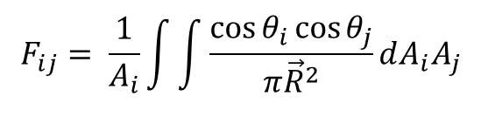
Methodology: View factor computation
Outline:
Background
Motivation
Methodology
Validation
Results
Discussion
Conclusion
$$F_{ij}= \frac{1}{A_{i}}\int{\int{\frac{\cos{θ_{i}}\cos{θ_{j}}}{π{\vec{R}}^{2}}}}dA_{i}A_{j}$$
View factor:
$$F_{ij}= \frac{1}{A_{i}}\sum_{i=1}^{N_{i}}{\sum_{j=1}^{N_{j}}{\frac{\cos{θ_{i}}\cos{θ_{j}}}{π{\vec{R}}^{2}}}}dA_{i}A_{j}$$
View factor summation:
Every differential area of the emitter surface creates a corresponding ray for each receiver differential area, where the ray vectors are determined by the centroidal locations of each triangle, as determined from the STL file.
$2020$ July $22nd$
Notes:
TEGs have direct energy conversion, no moving parts (low complexity), and a long lifespan. Power generation for deep space missions and waste heat recovery for automobiles

Slide 8
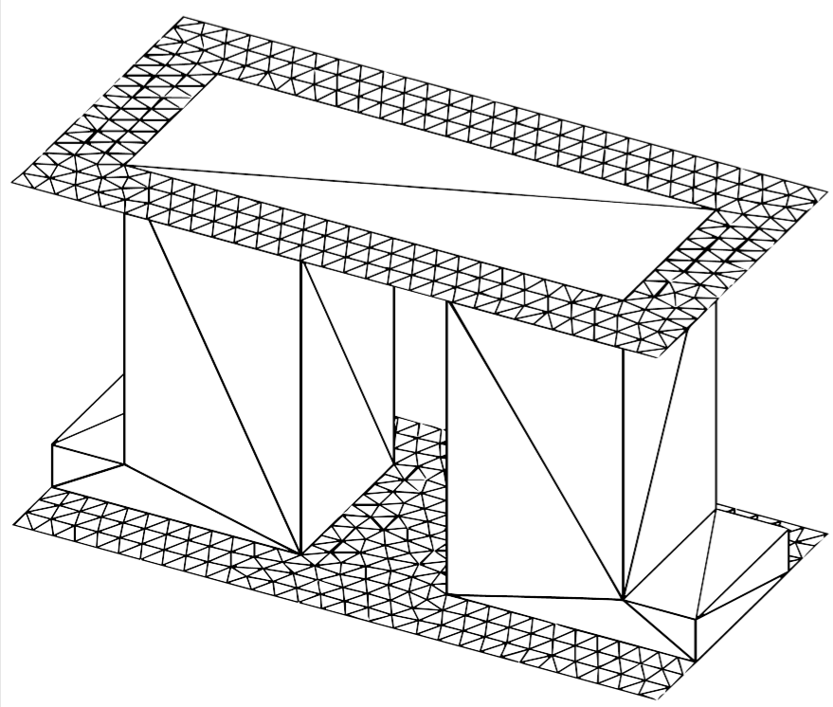
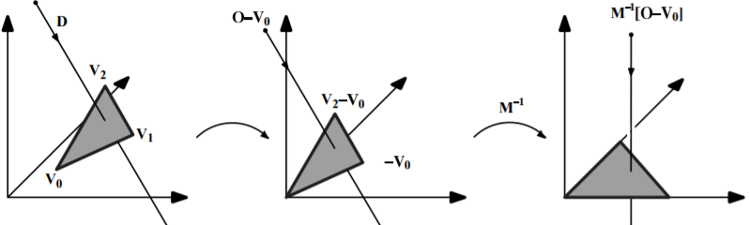

Methodology: Shadow effect and Möller–Trumbore intersection algorithm
Outline:
Background
Motivation
Methodology
Validation
Results
Discussion
Conclusion
Shadow effect: a phenomenon that represents any potential ray intersection with a non-participating surface
Reduces view factor magnitude
Möller–Trumbore ray-triangle intersection algorithm:
“Fast, minimum storage ray-triangle intersection” ($1997$) in Journal of graphics tools
Example of shadow effect
$2020$ July $22nd$
Notes:
ANNOTATE THE ABOVE FIGURE WITH U-V PLANE, RAY VECTOR, ETC.

Slide 9
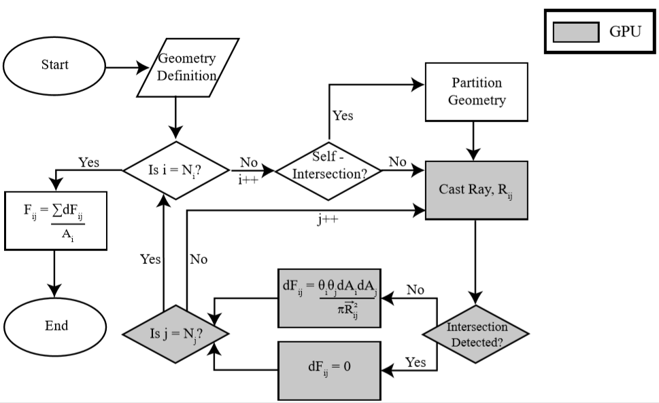
Methodology: Flow chart
Notes:
TEGs have direct energy conversion, no moving parts (low complexity), and a long lifespan. Power generation for deep space missions and waste heat recovery for automobiles

Slide 10
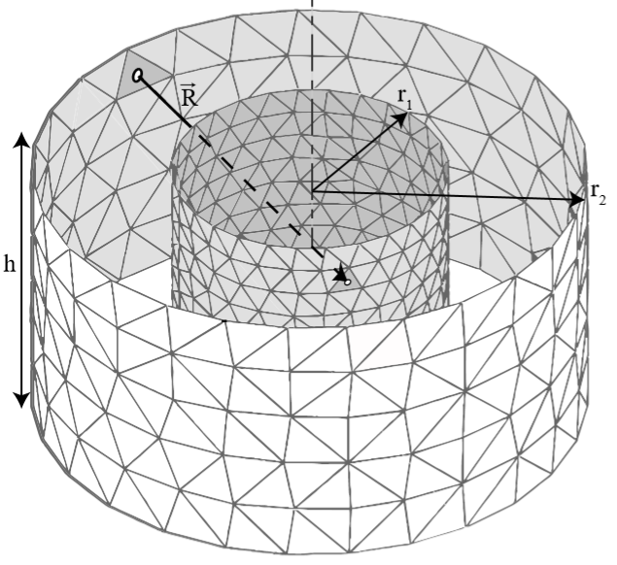
Methodology: Self-intersection
Outline:
Background
Motivation
Methodology
Validation
Results
Discussion
Conclusion
Self-intersection : refers to any obstructive surface, intrinsic of either emitting or receiving surface, that need checked by the MT algorithm for possible ray-intersection to properly resolve the view factor
Normally exhibited in curved surfaces
Concentric cylinders that exhibit self-intersection
$2020$ July $22nd$

Slide 11
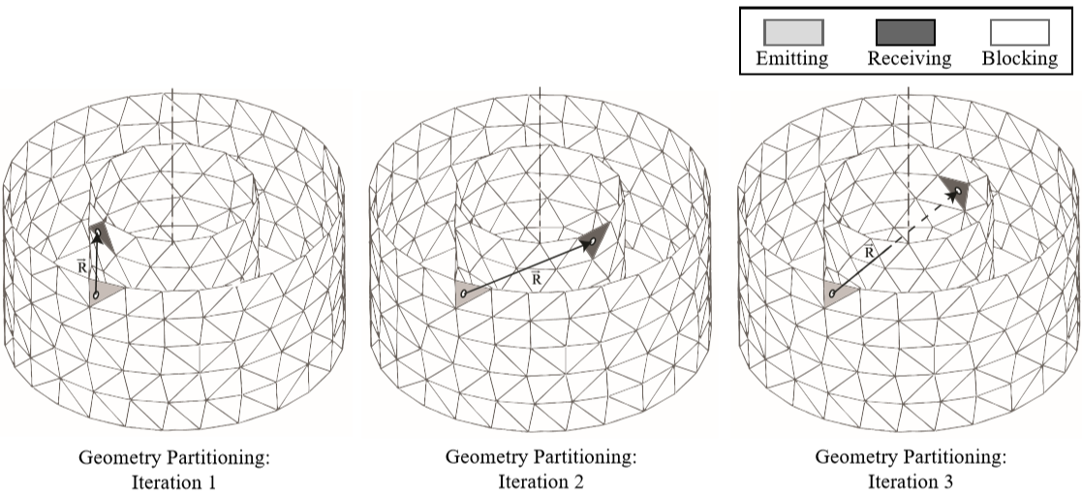
Methodology: Self-intersection algorithm
Outline:
Background
Motivation
Methodology
Validation
Results
Discussion
Conclusion
Self-intersection algorithm: dynamics updates the emitting/receiving surfaces to consider only one tessellation at a time
All other surfaces are considered non-participatory (blocking)
Dynamic geometry partitioning during self-intersection algorithm
$2020$ July $22nd$
Notes:
ANNOTATE THE ABOVE FIGURE WITH U-V PLANE, RAY VECTOR, ETC.

Slide 12
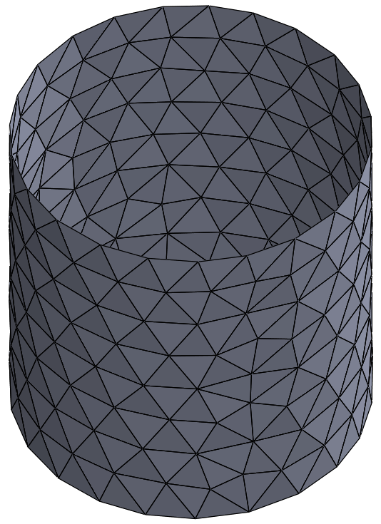

Methodology: Back-face culling
Outline:
Background
Motivation
Methodology
Validation
Results
Discussion
Conclusion
Back-face culling: a computer graphics technique that refers to the removal of primitive geometries that face away from the camera
In this context, tessellations that “face away” from the emitting tessellation appear clockwise oriented
Increases computational savings and it prevents intersection miscalculations.
Culling enabled
Viewers
$2020$ July $22nd$

Slide 13
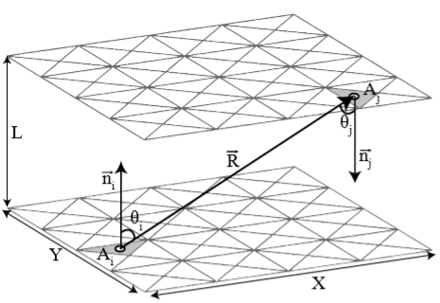
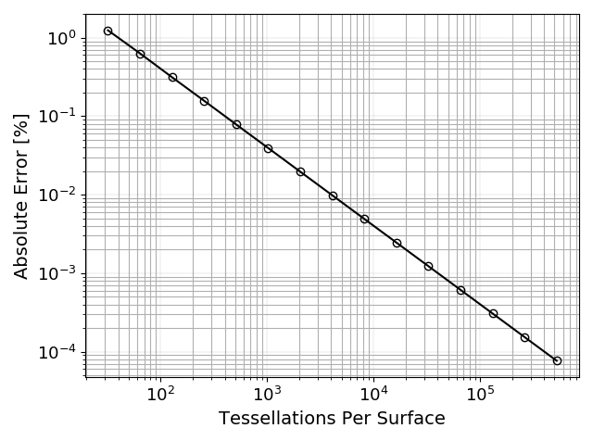
Validation: Analytical studies
Outline:
Background
Motivation
Methodology
Validation
Results
Discussion
Conclusion
To validate the program’s effectiveness, numerous geometries with published analytical solutions were inputted and tested
Parallel plates geometry
X/L = Y/L = 1.0
Spatial convergence with increasing mesh density
$2020$ July $22nd$

Slide 14
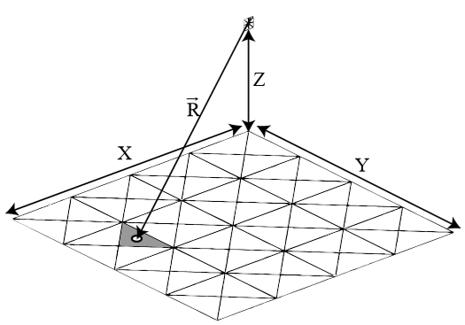
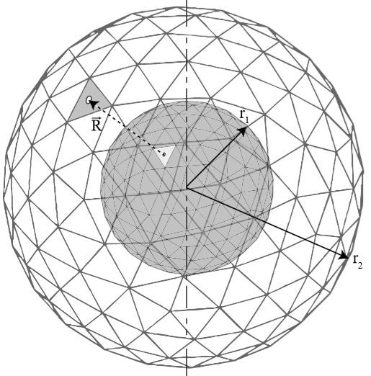
Validation: Analytical studies
Outline:
Background
Motivation
Methodology
Validation
Results
Discussion
Conclusion
More analytical test cases . . .
Analytical Soln. | Numerical Soln. | Percent Error
0.05573419 | 0.05573420 | 7.05725E-06
Analytical vs. numerical solutions for Z/X = 1.0, Y/X = 1.0
Analytical Soln. | Numerical Soln. | Percent Error
1.00 | 0.9988312 | 0.116872
Analytical vs. numerical solutions for r1 = 0.5 [mm], r2 = 1.0 [mm]
Note: MT, self-intersection, and culling are implemented in concentric spheres
$2020$ July $22nd$

Slide 15
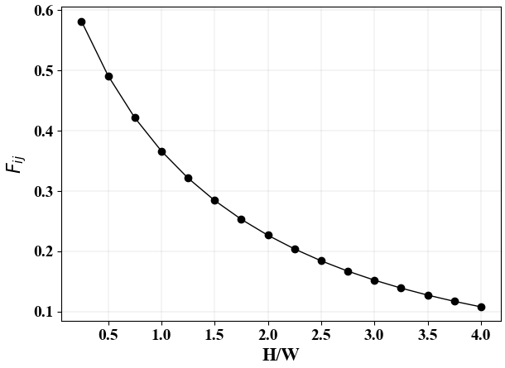
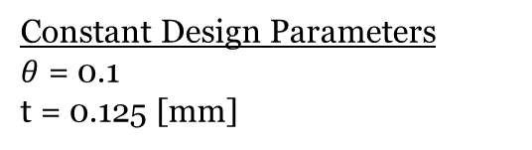
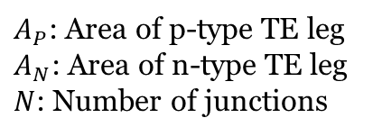
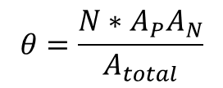
Results: Single-junction TEG
Outline:
Background
Motivation
Methodology
Validation
Results
Discussion
Conclusion
$$θ=\frac{N∗A_{P}A_{N}}{A_{total}}$$
$A_{P}$: Area of p-type TE leg
$A_{N}$: Area of n-type TE leg
$N$: Number of junctions
Constant Design Parameters
$θ$ = 0.1
t = 0.125 [mm]
Geometrical set-up
As demonstrated, the view factor decreases as H/W increases (with a constant interconnector thickness)
Due to increased prevalence of shadow effect
$2020$ July $22nd$

Slide 16
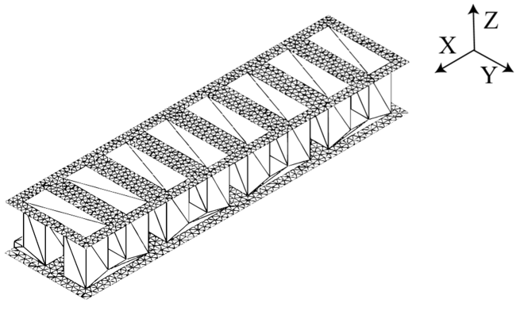
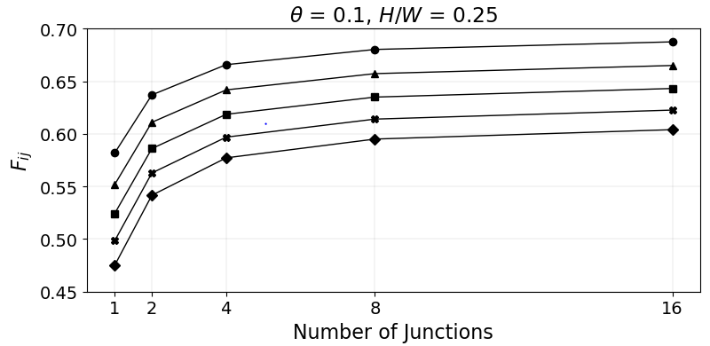
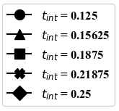
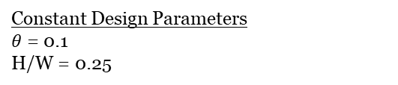
Results: Multi-junction TEG, H/W=0.25
Outline:
Background
Motivation
Methodology
Validation
Results
Discussion
Conclusion
Increase junctions
N=1
N=8
Asymptotic behavior observed in the view factor
Constant Design Parameters
$θ$ = 0.1
H/W = 0.25
$2020$ July $22nd$

Slide 17
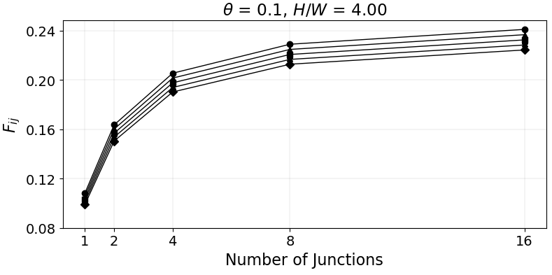
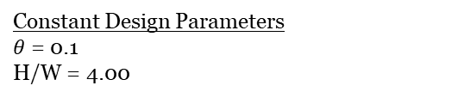
Results: Multi-junction TEG, H/W=4.00
Outline:
Background
Motivation
Methodology
Validation
Results
Discussion
Conclusion
Increase junctions
N=1
N=8
Asymptotic behavior observed in the view factor
Constant Design Parameters
$θ$ = 0.1
H/W = 4.00
$2020$ July $22nd$

Slide 18
Discussion: TEG modeling implications
Outline:
Background
Motivation
Methodology
Validation
Results
Discussion
Conclusion
Asymptotic curve demonstrates that a realistic model (N>128) could be modeled with a simpler model (N = 16)
Number of Junctions | View Factor | Absolute Difference
1 | 0.58177071
2 | 0.637026446 | 0.055256
4 | 0.665832591 | 0.028806
8 | 0.680281868 | 0.014449
16 | 0.68751517 | 0.007233
128 | 0.694024679 | 0.00651
View factor values for various junction sizes: θ = 0.1 H/W = 0.25, t = 0.125 [mm].
View Factor: N = 16 | View Factor: N = 128 | Percent Difference
0.68751517 | 0.69402468 | 0.942356%
Percent difference between a 16 junction TEG and a 128 junction TEG
$2020$ July $22nd$

Slide 19
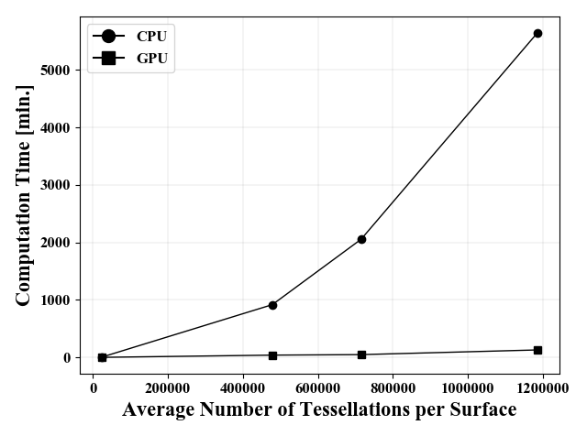
Discussion: Computational Speedup
Outline:
Background
Motivation
Methodology
Validation
Results
Discussion
Conclusion
Computational time comparison between the CPU (i9-9980XE) and GPU (i9-9980XE + 2080TI) for a single-junction TEG with θ = 0.1, H/W = 0.25, t = 0.125 [mm]
GPU-acceleration becomes increasingly important as junction size grows
$2020$ July $22nd$

Slide 20
Conclusion
Outline:
Background
Motivation
Methodology
Validation
Results
Discussion
Conclusion
GPU-accelerated programming allows for a robust view factor calculator
Shadow effect: MT algorithm
Curved surfaces: self-intersection algorithm, culling enabled
As distance across a TEG hot- and cold-sides increases, the view factor decreases
For constant design parameters, as junction number increases, the view factor behaves asymptotically
Can estimate a large and complex models with simpler models
This methodology facilitates the ability the design and analysis of high-temperature TEGs.
$2020$ July $22nd$

Slide 21
Acknowledgements:
Outline:
Background
Motivation
Methodology
Validation
Results
Discussion
Conclusion
Computational resources provided by the Center for Research Computing (CRC) at the University of Pittsburgh
$2020$ July $22nd$

